Slide 1
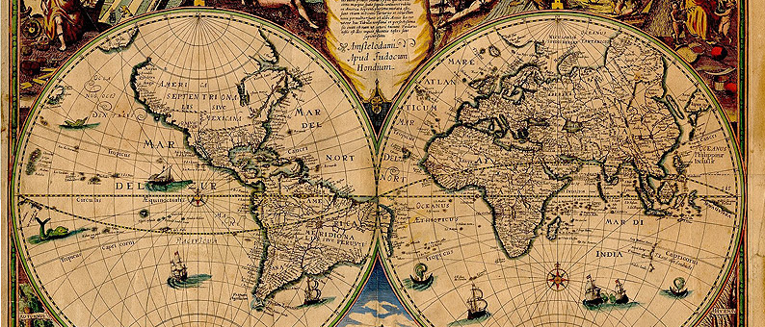

MOD004089 GIS Tools for Biodiversity Mapping and Conservation
Projection Systems, GPS and Tracking
Dr Hannah White

Slide 2
Aims
Where things (including you!) are in space
Coordinates and projection systems (representation in space)
GPS (identifying a location)
Tracking systems (movement between locations)

Slide 3
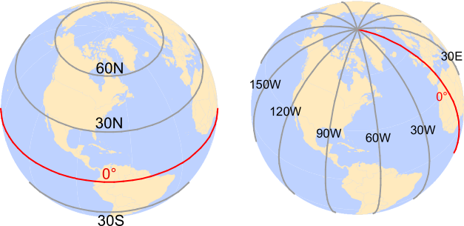
Coordinates
Parallels
Different lengths
Natural 0 parallel (equator)
Meridians
Connect poles
Same length

Slide 4
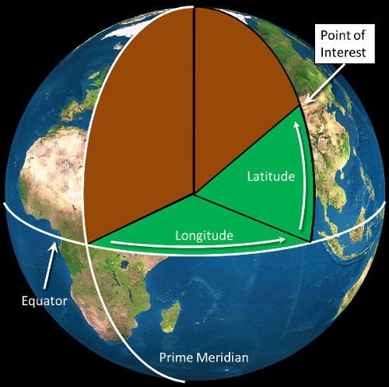
Coordinates

Slide 5
Latitude and Longitude
Units are degrees º
E.g. N 52º 31’ 12’’
1’ = 60’’ and 1º = 60’
Need to convert to decimal degrees

Slide 6
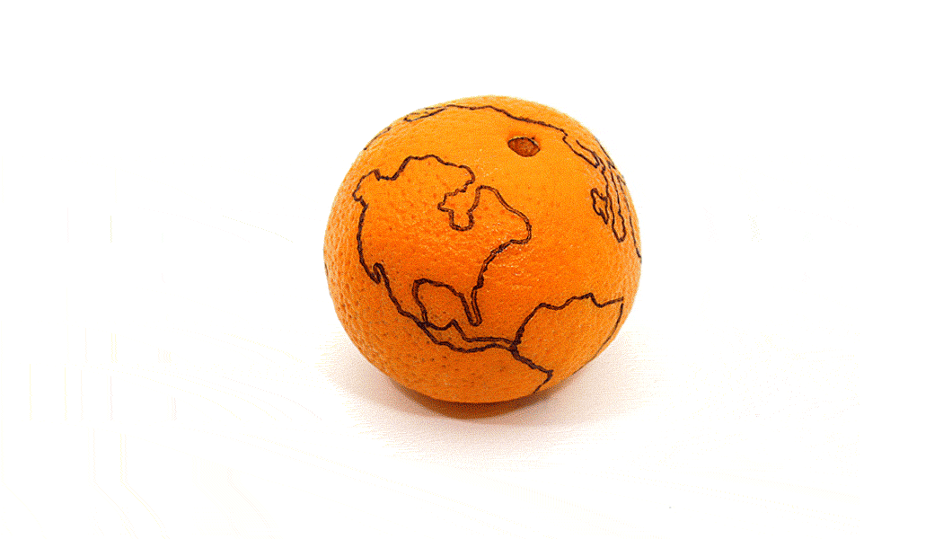
Projections

Slide 7
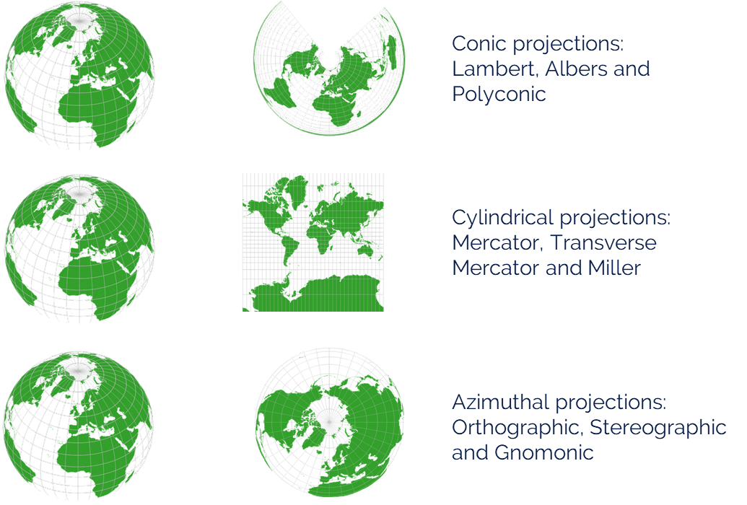
Projections
All projections contain some distortion
Area
Distance
Shape

Slide 8
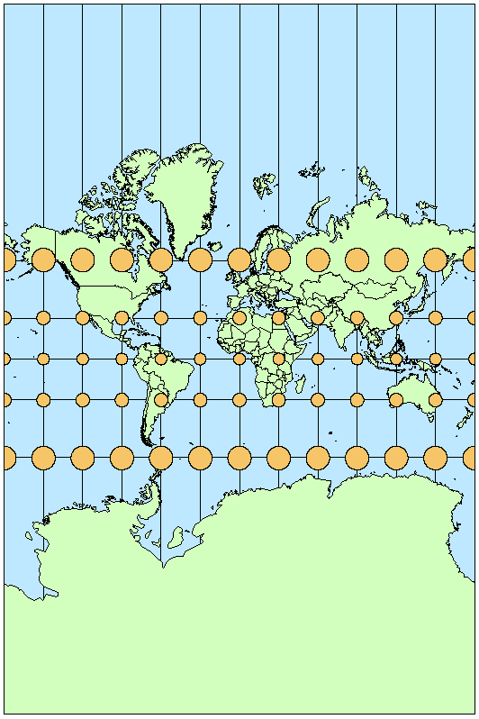
Global Projections - Mercator
Mercator
Tissot circles have same area
Maintains shape
Meridians are parallel
Directions are straight line
Bad for area and distances

Slide 9
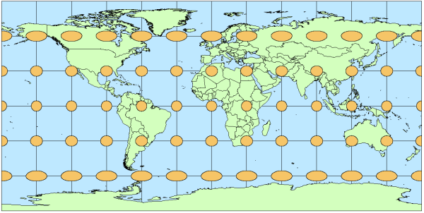
Global Projections - Equirectangular
Equirectangular (Plate Carrée)
Area better represented
Shape poorly maintained
Meridians are parallel
Good for area and directions
Bad for distances

Slide 10
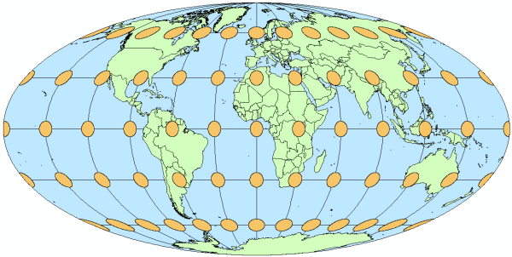
Global Projections - Mollweide
Mollweide
Good for area and shape
Meridians not parallel
Bad for directions

Slide 11
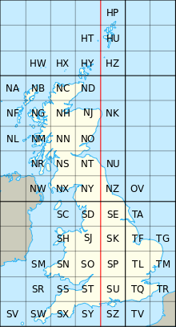
Coordinate Reference Systems
Components
Projection
Datum (reference/starting point)
Units
1000s to choose from with unique EPSG code
Choice based on where, extent and what you are measuring?
Most countries have own projected CRS e.g. British National Grid (EPSG: 27700)

Slide 12
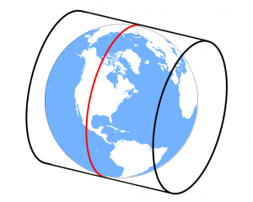
Universal Transverse Mercator
UTM useful if no local CRS
Cylindrical projection
Horizontal cylinder
Different cylinder depending on where you are

Slide 13
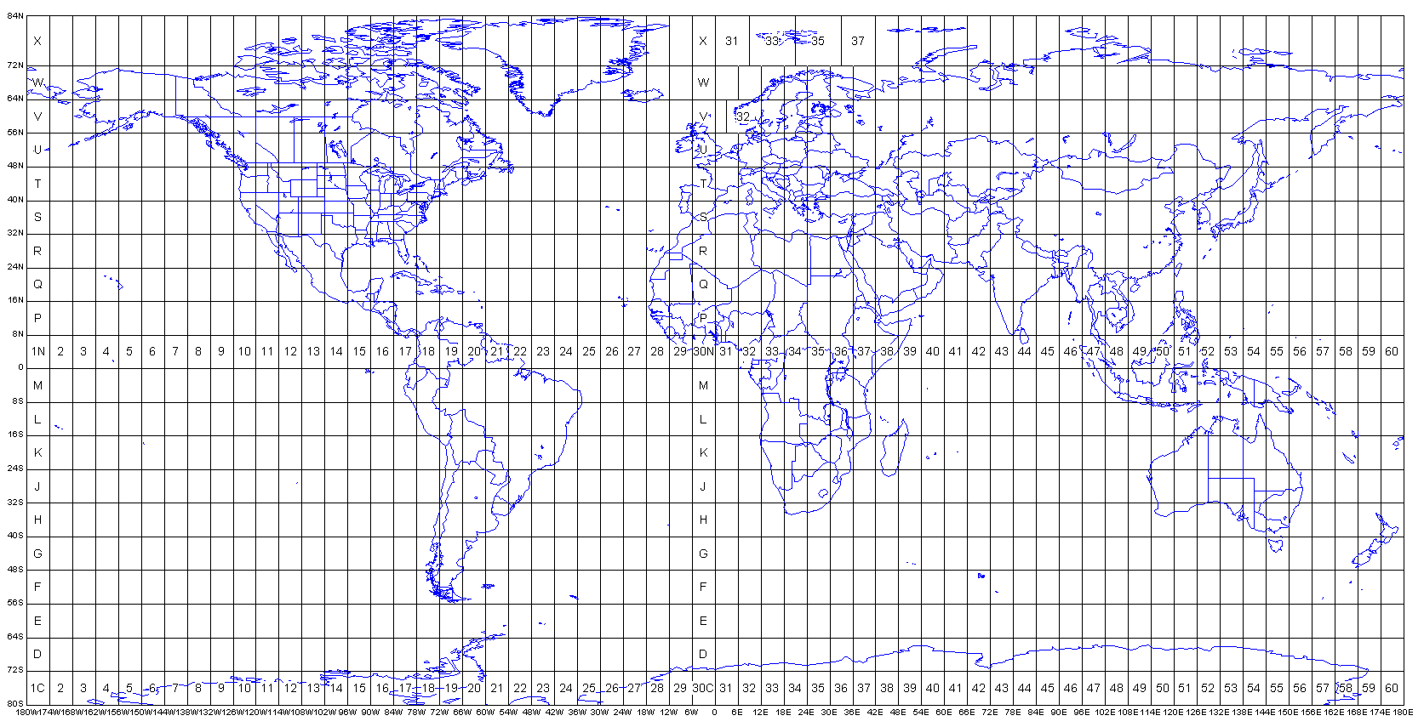
Universal Transverse Mercator

Slide 14
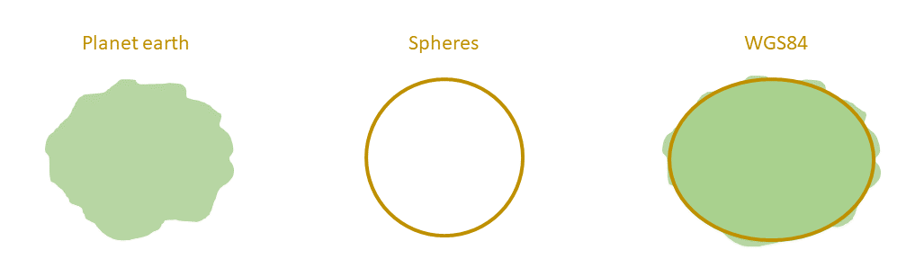
Global Maps
Use global CRS and stay in latitude and longitude
WGS 84 (latest model of Earth)
ESPG 4326
Units are degrees (compare to projected CRS in metric units)

Slide 15
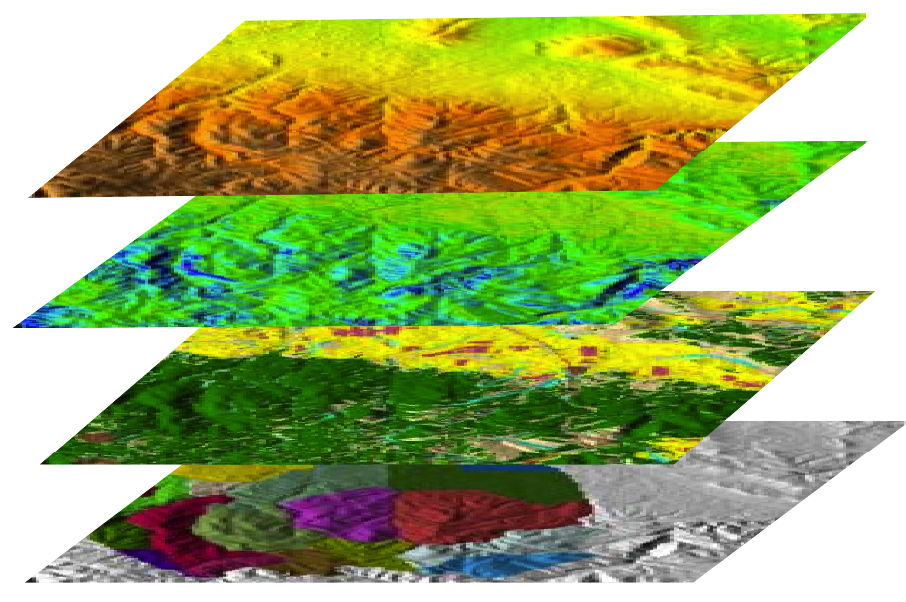
GIS
Define CRS of project
Different layers may have different CRS – on-the-fly transformation
Golden Rule: All layers should have same projection
Transform all layers to match project coordinate system - Reprojection

Slide 16
British National Grid
Based on UTM but alphanumeric!
E.g. TL6461327137
TL = 100 x 100 km
TL62 = 10 x 10 km
TL6427 = 1 x 1 km
Keep going to 1 x 1 m
which would give 10 digits

Slide 17
British National Grid
Convert to Easting and Northing (6 digits!)
Find coordinates of bottom left of square
E.g. TL6461327137
Easting: 564613 m
Northing: 227137 m
E.g. TL6427
Easting: 564000 m
Northing: 227000 m

Slide 18
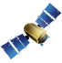
Global Positioning System
Global Positioning System
US army – series of satellites that transmit signal to a receiver
Time how long it takes signal to travel and use triangulation to determine location
Accuracy increases with number of satellites ‘seen’
~ 5m accuracy

Slide 19
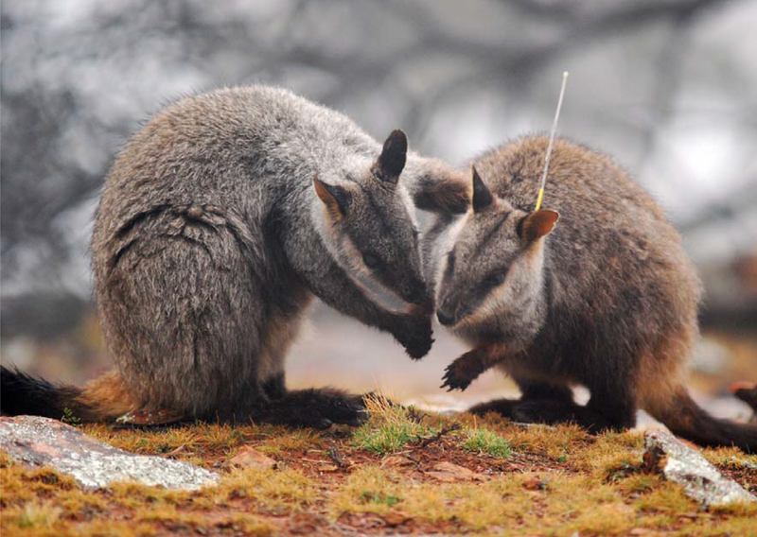
Tracking Systems – Radio Tracking
1960s (pre-GPS)
Radiotransmitter with receiver (antenna) to obtain direction
Triangulation with multiple antenna
Pros: cheap, reliable, good lifespan, light, no recovery necessary
Cons: low accuracy, need people in the field
Rock wallaby with radio transmitter

Slide 20
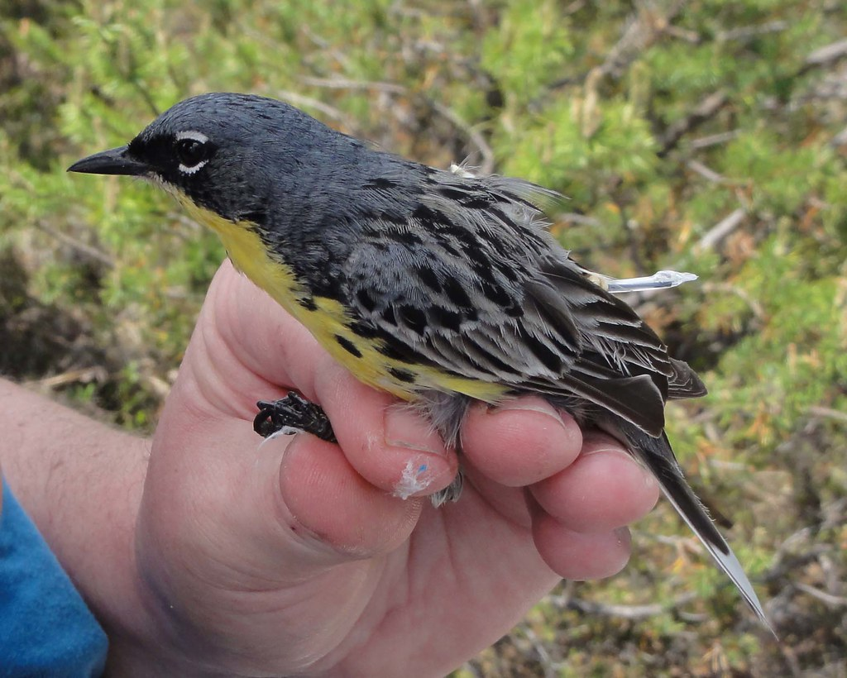
Tracking Systems – Geolocator
Pre-GPS
Time sunrise and sunset to estimate location
Often used for long migrations
Pros: cheap, light, long lifespan
Cons: low accuracy (~100 km), recovery needed, complex analysis
Kirtland’s warbler with geolocator attached

Slide 21
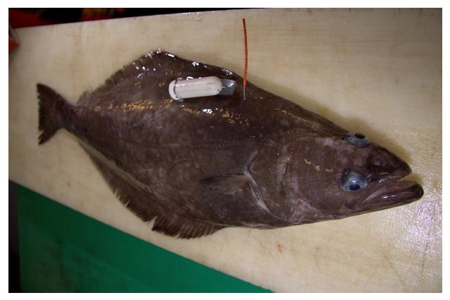
Tracking Systems – Compass Loggers
Measure changes in direction
Assumes constant speed
Only solution for many marine animals (radio does not penetrate water)
Pros: cheap, light, long lifespan
Cons: low accuracy, don’t know distances, recovery needed
Compass logger on flatfish species

Slide 22
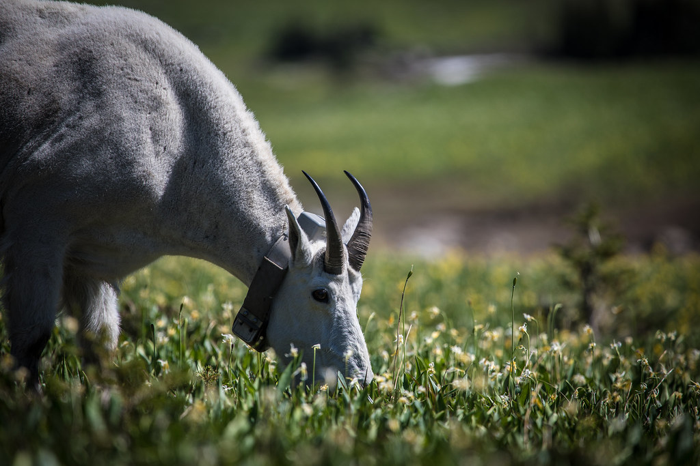
Tracking Systems – GPS Logger
Chips for GPS loggers are getting smaller
Pros: high accuracy, potentially long lifespan
Cons: expensive, recovery needed
Mountain goat with GPS collar

Slide 23
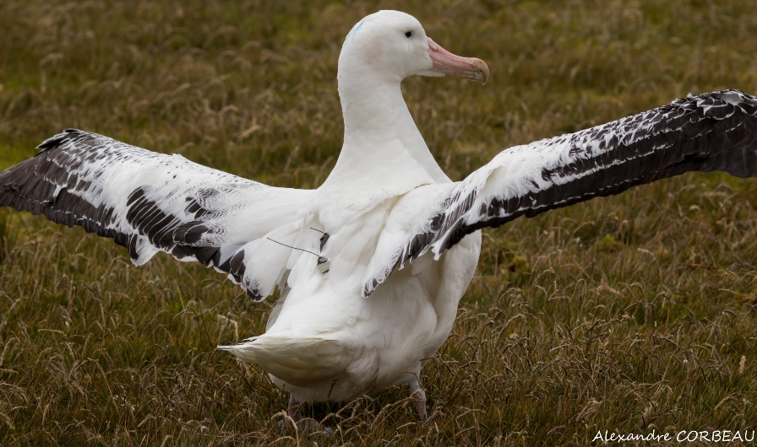
Tracking Systems – Argos System
GPS device able to send data to satellite
Pros: high accuracy, no recovery necessary
Cons: expensive and need to rent satellite time, short life span
Albatross with Argos tracker

Slide 24
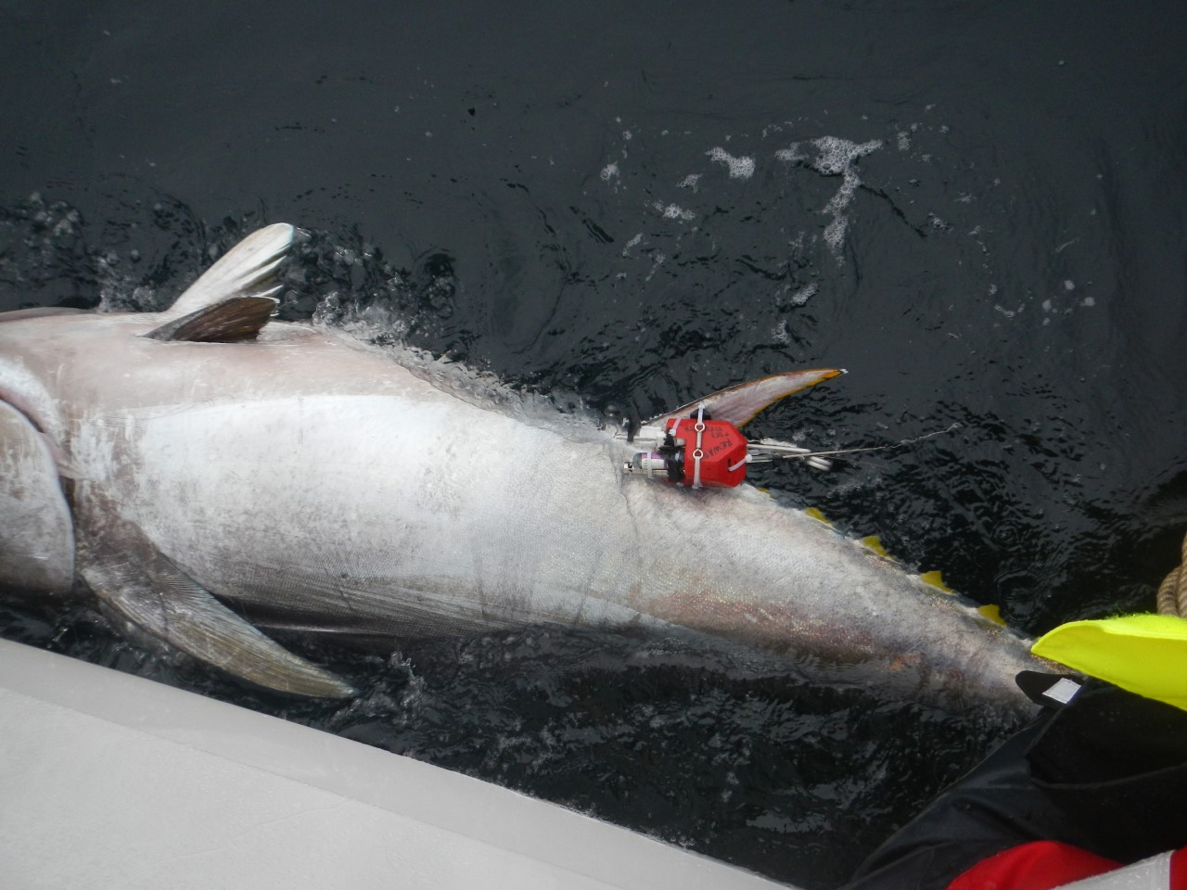
Tracking Systems – Satellite Telemetry
Send signal to satellite and satellite calculates device position
Short amount of time to send signal
Marine mammals spending short amounts of time at surface
Pros: no recovery needed
Cons: expensive, short life span, large size
Blue fin tuna with satellite tag, accelerometer and radio tracker

Slide 25
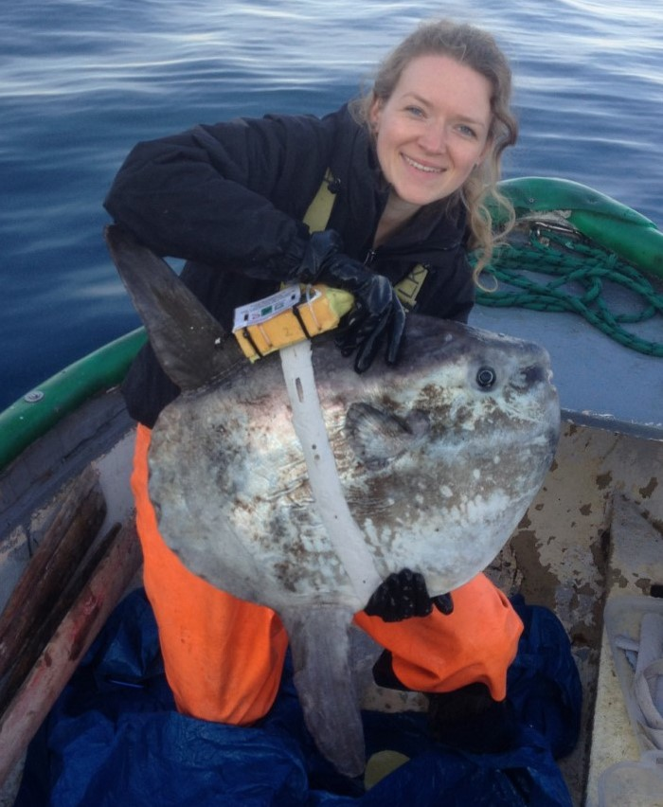
Choice of Tracking Systems
Can I recapture the animal?
What accuracy do I need?
What frequency of recording do I need?
How easy is it to attach to the animal?
Additional devices can be added to measure other parameters e.g. acceleration, pressure, temperature
Dr Natasha Phillips with sunfish tag harness

Slide 26
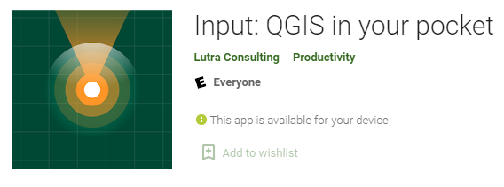
What have we talked about today?
Projections and coordinate reference systems – getting the orange peel flat
GPS – using satellites for determining location (more in practical)
Tracking devices – lots of technology to choose from

